Slide 1
Animation Environment for Linked Data Structures
Supervisor: Kieran Herley
Student: Kiu Man Yeung

Slide 2
Motivation
Help beginner programmers
Data Structures are foreign
Visual learning is crucial
Traditional debugging tools are not expressive
Reflect student’s algorithm in graphs

Slide 3
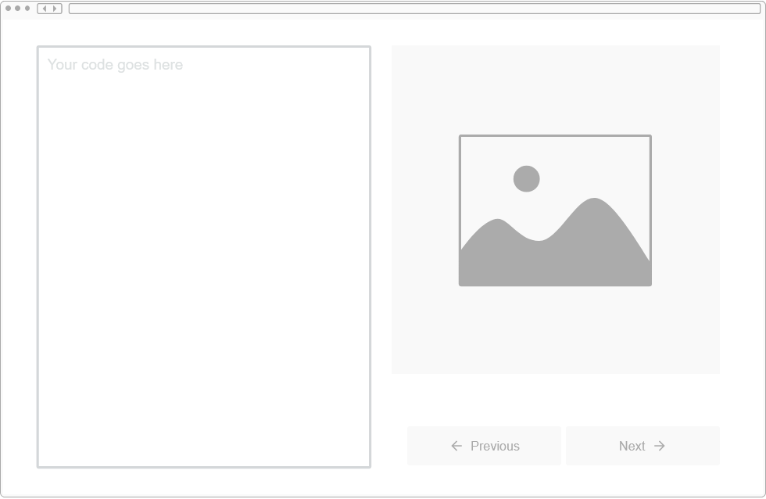
Plan - Features
Python code analysis
Step-by-step graphical display
Line indication

Slide 4
Plan - Architecture
GUI: tkinter
Code analysis: AST
Graphing tool: Graphviz , lolviz

Slide 5
Graphs
Graphviz
Opensource graph visualisation software
Display structural information
Render graphs (dot languages) into images
Lolviz
Package to turn arbitrary objects into graph objects
Formats and display objects in a nice way

Slide 6
Abstract Syntax Trees(AST)
Parse Python code into grammar tree
Allows modification to the tree

Slide 7
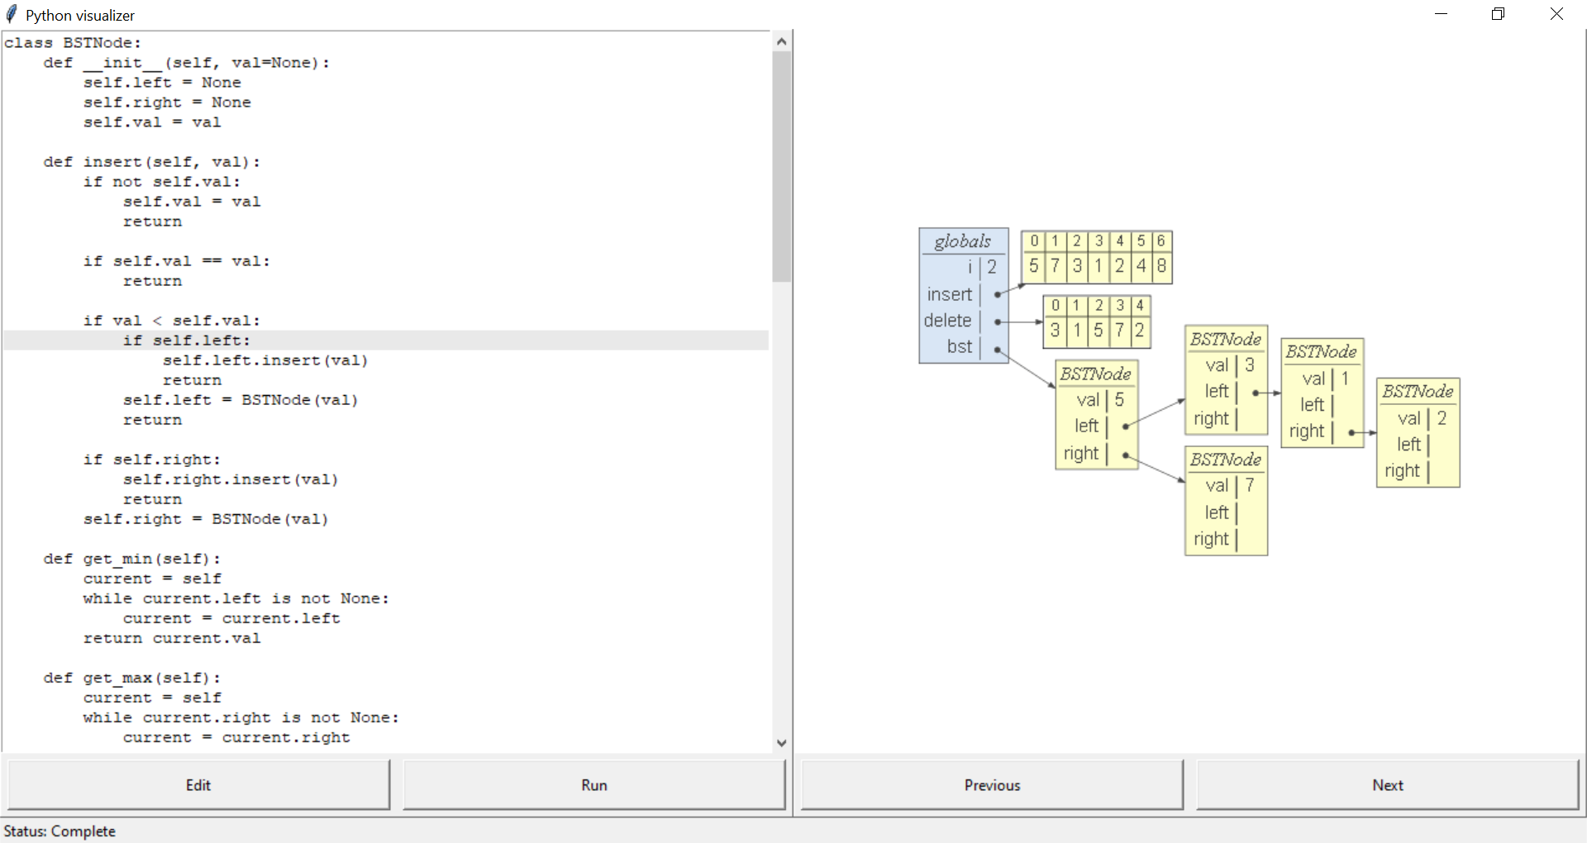
Product Demo

